Slide 1


Reading from a File

Slide 2
Revision: Writing in File
Storing output in the file is a five-step process:
Include the header file fstream in the program.
Declare file stream variables.
Associate the file stream variables with the text file and define the opening mode.
Use the file stream variables insertion operator << (to store output in the file i.e., write in the file)
Close the file.
Notes:
If we adopt Project Based approach for learning programming, and divide our problem into small computational steps, and learn the related Syntax.
Then using this approach we can make our own Games, Websites and Mobile Apps easily.

Slide 3
Revision
Write a C++ Program to store “Welcome to UET” in a text file.
#include <fstream>
using namespace std;
main()
{
string line = "Welcome to UET";
fstream newFile;
newFile.open("TextFile.txt", ios::out);
newFile << line;
newFile.close();
}
Notes:
After this lecture, you shall be able to explain the Hardware Components (that are input output devices, CPU and memory) and their role while computing any problem.

Slide 4
File Stream: Reading from a File
Taking input from the file is also a five-step process:
Include the header file fstream in the program.
Declare file stream variables.
Associate the file stream variables with the text file and define the opening mode.
Use the file stream variables with extraction operator >> (to take input from the file i.e., read the file).
Close the file.
Notes:
If we adopt Project Based approach for learning programming, and divide our problem into small computational steps, and learn the related Syntax.
Then using this approach we can make our own Games, Websites and Mobile Apps easily.

Slide 5
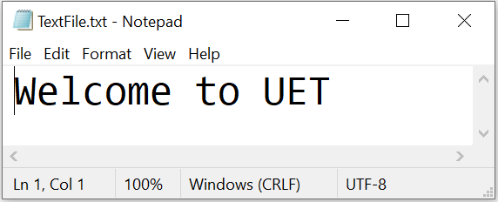
Working Example
Write a C++ Program to read “Welcome to UET” from a text file and show it on the console.
Notes:
After this lecture, you shall be able to explain the Hardware Components (that are input output devices, CPU and memory) and their role while computing any problem.

Slide 6
Working Example
Step 1: Include the header file fstream in the program.
#include<iostream>
#include <fstream>
using namespace std;
main()
{
}
Notes:
After this lecture, you shall be able to explain the Hardware Components (that are input output devices, CPU and memory) and their role while computing any problem.

Slide 7
Working Example
Step 2: Declare file stream variable to open the file.
#include<iostream>
#include <fstream>
using namespace std;
main()
{
string line;
fstream newFile;
}
Notes:
After this lecture, you shall be able to explain the Hardware Components (that are input output devices, CPU and memory) and their role while computing any problem.

Slide 8
Working Example
Step 3: Associate the file stream variables with the text file and define the opening mode.
#include<iostream>
#include <fstream>
using namespace std;
main()
{
string line;
fstream newFile;
newFile.open("TextFile.txt", ios::in);
}
Notes:
After this lecture, you shall be able to explain the Hardware Components (that are input output devices, CPU and memory) and their role while computing any problem.

Slide 9
Working Example
Step 4: Use the file stream variables extraction operator >> (to read from the file).
#include<iostream>
#include <fstream>
using namespace std;
main()
{
string line;
fstream newFile;
newFile.open("TextFile.txt", ios::in);
newFile >> line;
}
Notes:
After this lecture, you shall be able to explain the Hardware Components (that are input output devices, CPU and memory) and their role while computing any problem.

Slide 10
Working Example
Step 5: Close the file.
#include<iostream>
#include <fstream>
using namespace std;
main()
{
string line;
fstream newFile;
newFile.open("TextFile.txt", ios::in);
newFile >> line;
newFile.close();
}
Notes:
After this lecture, you shall be able to explain the Hardware Components (that are input output devices, CPU and memory) and their role while computing any problem.

Slide 11
Working Example
Display output on the Console.
#include<iostream>
#include <fstream>
using namespace std;
main()
{
string line;
fstream newFile;
newFile.open("TextFile.txt", ios::in);
newFile >> line;
newFile.close();
cout << line;
}
Notes:
After this lecture, you shall be able to explain the Hardware Components (that are input output devices, CPU and memory) and their role while computing any problem.

Slide 12
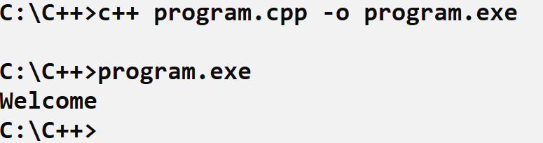
Working Example: Output
Output on the Console is:
Notes:
After this lecture, you shall be able to explain the Hardware Components (that are input output devices, CPU and memory) and their role while computing any problem.

Slide 13
Working Example: Output
Can anyone tell why we only got “Welcome” instead of “Welcome to UET”?
Notes:
After this lecture, you shall be able to explain the Hardware Components (that are input output devices, CPU and memory) and their role while computing any problem.

Slide 14
Working Example: Output
It reads only 1 word from the file until cursor reaches a blank space. Following program will only print “Welcome”
#include<iostream>
#include <fstream>
using namespace std;
main()
{
string line;
fstream newFile;
newFile.open("TextFile.txt", ios::in);
newFile >> line;
newFile.close();
cout << line;
}

Slide 15
Working Example: Output
What we have to do to read the complete line?
#include<iostream>
#include <fstream>
using namespace std;
main()
{
string line;
fstream newFile;
newFile.open("TextFile.txt", ios::in);
newFile >> line;
newFile.close();
cout << line;
}
Notes:
After this lecture, you shall be able to explain the Hardware Components (that are input output devices, CPU and memory) and their role while computing any problem.

Slide 16
Working Example: Output
We have to use getline(file_variable, string_variable) function.
#include<iostream>
#include <fstream>
using namespace std;
main()
{
string line;
fstream newFile;
newFile.open("TextFile.txt", ios::in);
newFile >> line;
newFile.close();
cout << line;
}
Notes:
After this lecture, you shall be able to explain the Hardware Components (that are input output devices, CPU and memory) and their role while computing any problem.

Slide 17
Working Example: Output
Following code will print ”Welcome to UET” on the screen
#include<iostream>
#include <fstream>
using namespace std;
main()
{
string line;
fstream newFile;
newFile.open("TextFile.txt", ios::in);
getline(newFile, line);
newFile.close();
cout << line;
}
Notes:
After this lecture, you shall be able to explain the Hardware Components (that are input output devices, CPU and memory) and their role while computing any problem.

Slide 18
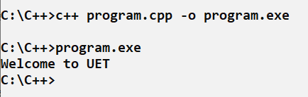
Working Example: Output
Output on the Console is:
Notes:
After this lecture, you shall be able to explain the Hardware Components (that are input output devices, CPU and memory) and their role while computing any problem.

Slide 19
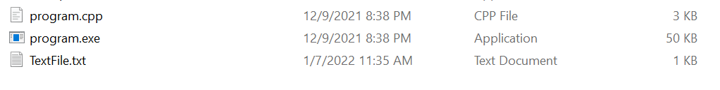
File in the Same Directory
Important thing to note here is that the .txt file we are reading is in the same directory as that of our .cpp file.
Notes:
After this lecture, you shall be able to explain the Hardware Components (that are input output devices, CPU and memory) and their role while computing any problem.

Slide 20
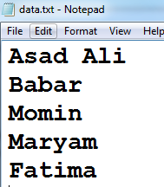
Reading all the contents from File
How to read all the names from the file and print on the console?
Notes:
After this lecture, you shall be able to explain the Hardware Components (that are input output devices, CPU and memory) and their role while computing any problem.

Slide 21
Reading all the contents from File
Now, we want to read the file until it reaches the end of file.
For that we have a function eof().
Syntax to use that function is:
file_variable.eof()
Notes:
After this lecture, you shall be able to explain the Hardware Components (that are input output devices, CPU and memory) and their role while computing any problem.

Slide 22
Reading all the contents from File
How to read all the names from the file and print on the console?
fstream file;
file.open("data.txt", ios::in);
string line;
while (!file.eof())
{
getline(file, line);
cout << line << endl;
}
file.close();
Notes:
After this lecture, you shall be able to explain the Hardware Components (that are input output devices, CPU and memory) and their role while computing any problem.

Slide 23

Learning Objective
Write C++ Program that reads permanently stored data from the text file.
Notes:
After this lecture, you shall be able to explain the Hardware Components (that are input output devices, CPU and memory) and their role while computing any problem.

Slide 24
Conclusion
Taking input from the file is also a five-step process:
Include the header file fstream in the program.
Declare file stream variables.
Associate the file stream variables with the text file and define the opening mode.
Use the file stream variables with extraction operator >> (to take input from the file i.e., read the file).
Close the file.
Notes:
If we adopt Project Based approach for learning programming, and divide our problem into small computational steps, and learn the related Syntax.
Then using this approach we can make our own Games, Websites and Mobile Apps easily.

Slide 25
Conclusion
file_variable >> only reads a single word from the file.
getline(file_variable, string_variable) is used to read a complete line from the user.
file_variable.eof() returns non-zero (true) when the cursor reaches end of the file, otherwise it returns zero.
Notes:
If we adopt Project Based approach for learning programming, and divide our problem into small computational steps, and learn the related Syntax.
Then using this approach we can make our own Games, Websites and Mobile Apps easily.

Slide 26

Self Assessment
1. Develop a SigIn and SignUp Application using File System.
As a user, when I signup to the system the username and password stores into the file.
As a user, when I signin to the system the username and password is verified from the file.

Slide 27
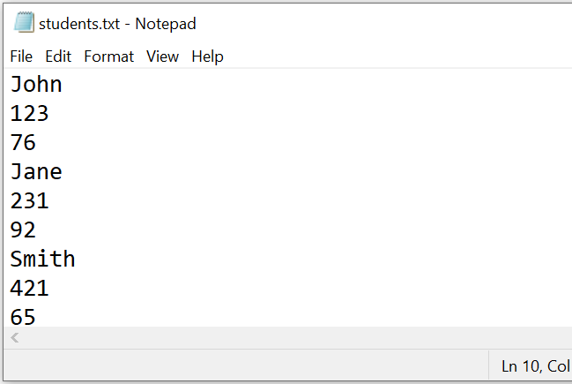
Self Assessment
Input

Slide 28
Self Assessment
2. A file "students.txt" has data stored like this on separate lines
Admission_number
Name
Percentage.
Write a function read_rec() in c++ that reads contents of the file "student.txt" and then write a function write_rec() that stores the details of those students whose percentage is above 75 in descending order in a separate file named “topperStudents.txt”.

Slide 29
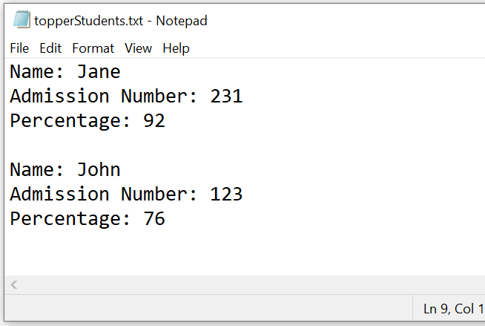
Self Assessment
Output

